Slide 1
Processing your Travel Claim
Using webBASIS to process your travel claim upon return from trip

Slide 2
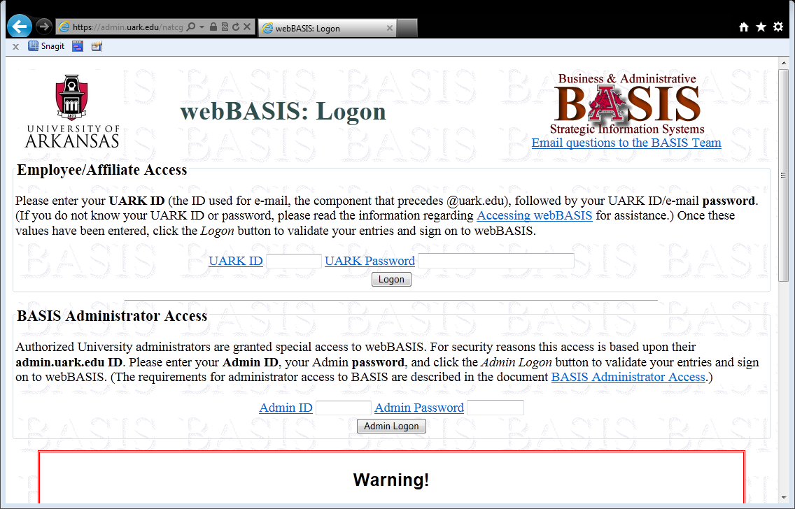
Notes:
You will log in through the Employee/Affiliate Access to process your Travel Claim.

Slide 3
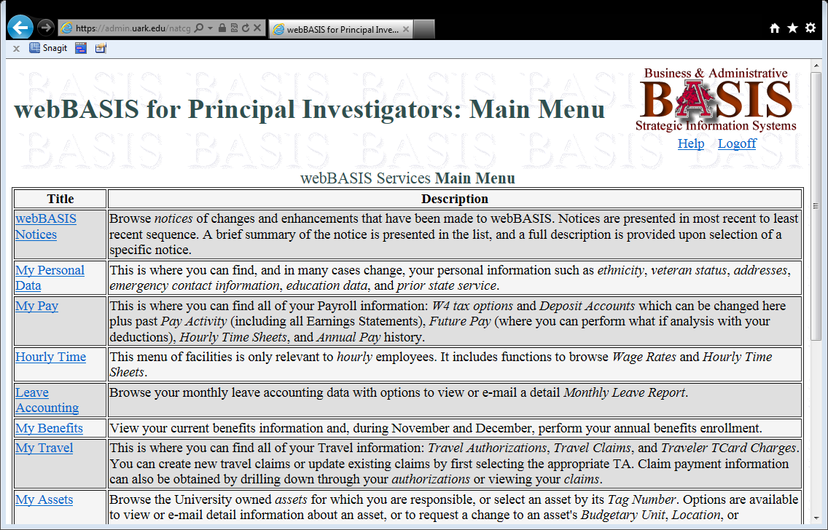
Notes:
Select the ‘My Travel’ link

Slide 4
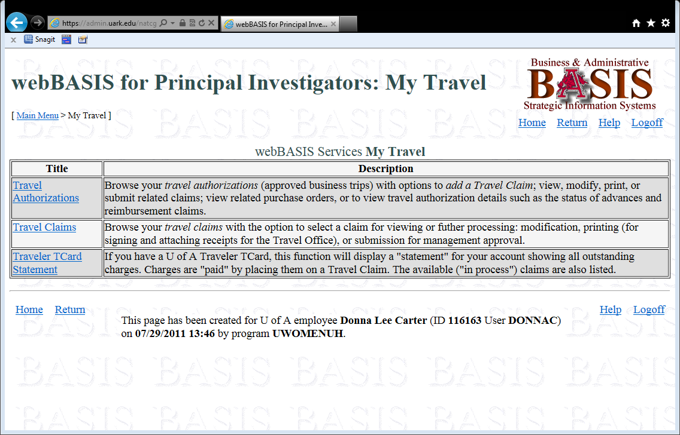
Notes:
You must select the ‘Travel Authorization’ link in order to find the Travel Authorization you are processing your claim against.

Slide 5
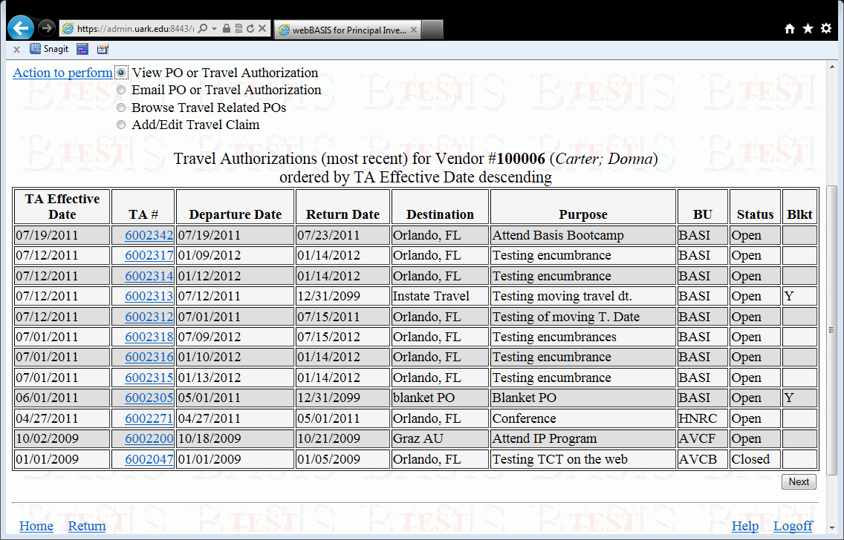
Notes:
Once you click on ‘Travel Authorizations’ a list of your Travel Authorizations will be displayed with the most current trip listed first.

Slide 6
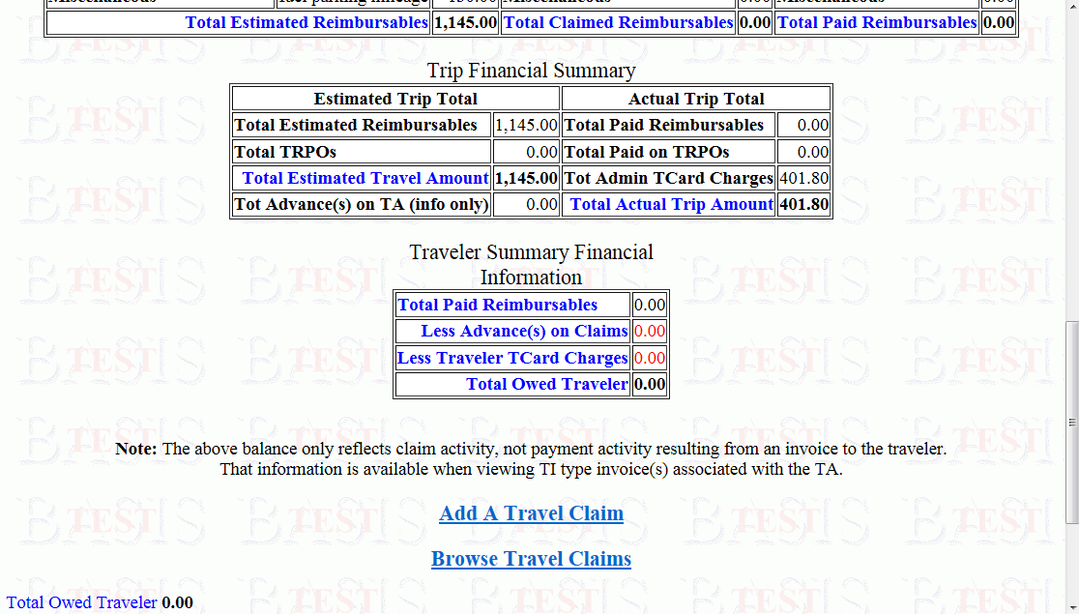
Notes:
Once you click on the TA number, you will see a snap shot of your Travel Authorization. Scroll down the page and you will see the link ‘Add a Travel Claim’.

Slide 7
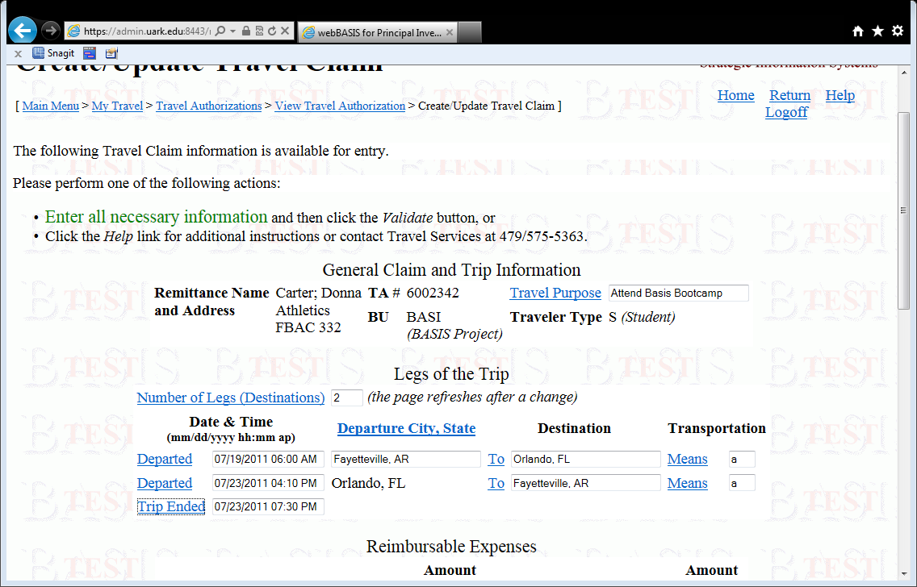
Notes:
You will now have the fields available for entering the information pertaining to your trip.

Slide 8
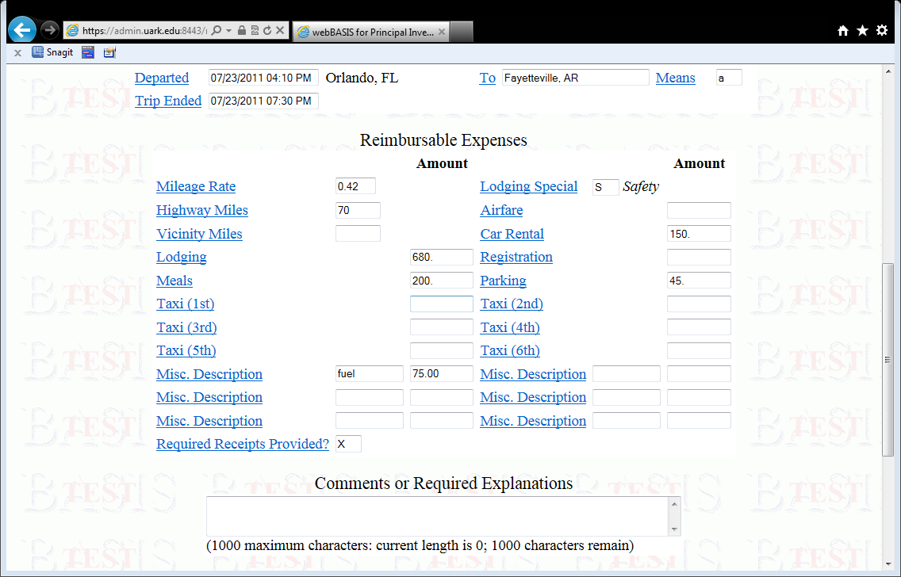
Notes:
This is the area where you will enter all of the costs that you incurred. Please Note: If you have a Traveler Tcard and you used your card on the trip, you will still associate allowable charges on this screen.

Slide 9
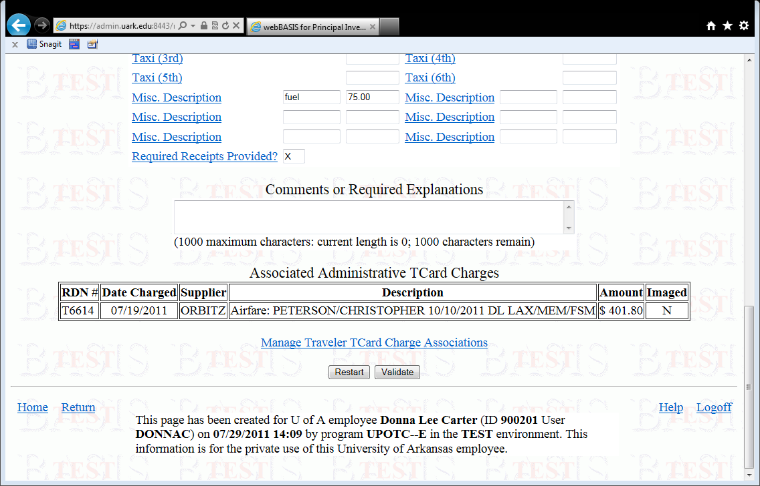
Notes:
If you have a Traveler Tcard and you have charges on your Tcard, you will have this link available for viewing to see if there are any charges that are related to the claim you are processing.
This will also show you if the Administrative Tcard has been used to purchase any airfare, registration, etc.

Slide 10
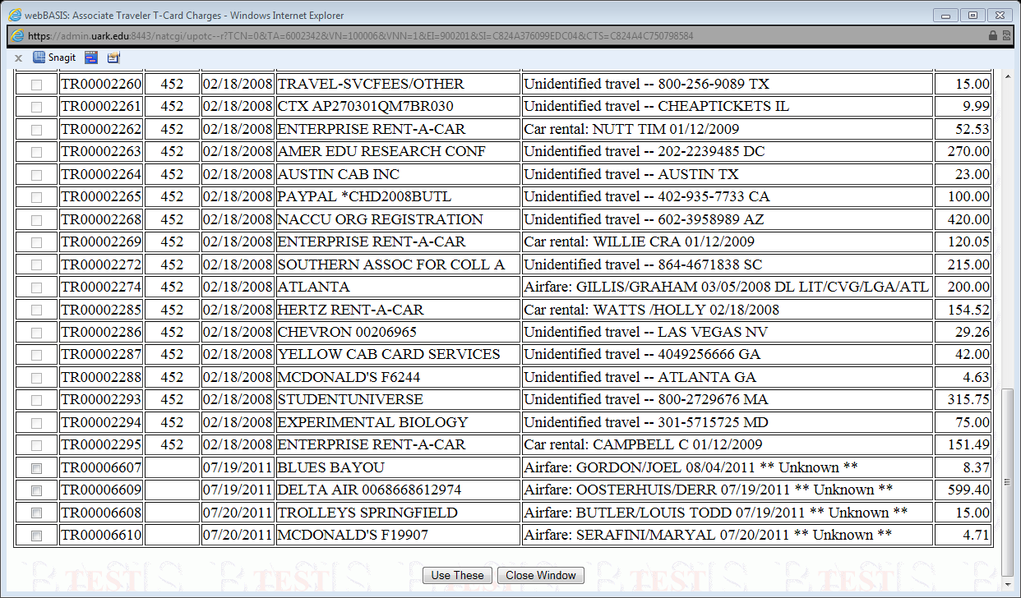
Notes:
You will notice that some of the Tcard charges are already attached to another claim, but the last 4 charges are available for selection IF they relate to the trip you are processing.

Slide 11
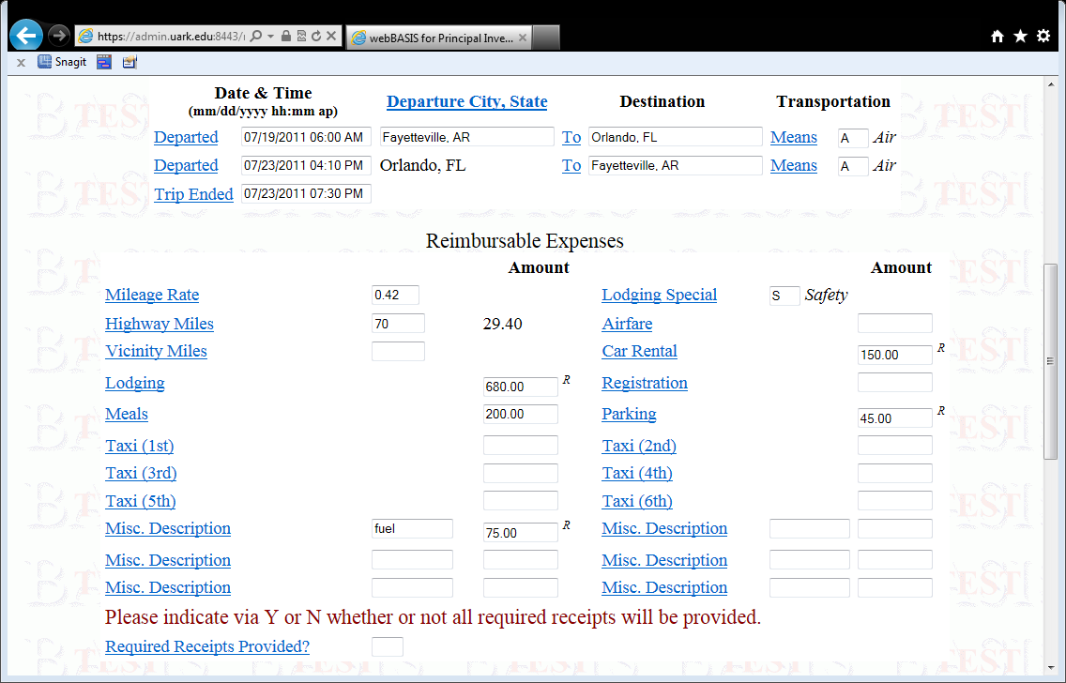
Notes:
Notice that all fields that require a receipt will have an’R’ out beside the field. Also the system will require you to say whether or not you have all of your required receipts. If you do not have all of them, you will be required to enter a comment as to why you do not have them.

Slide 12
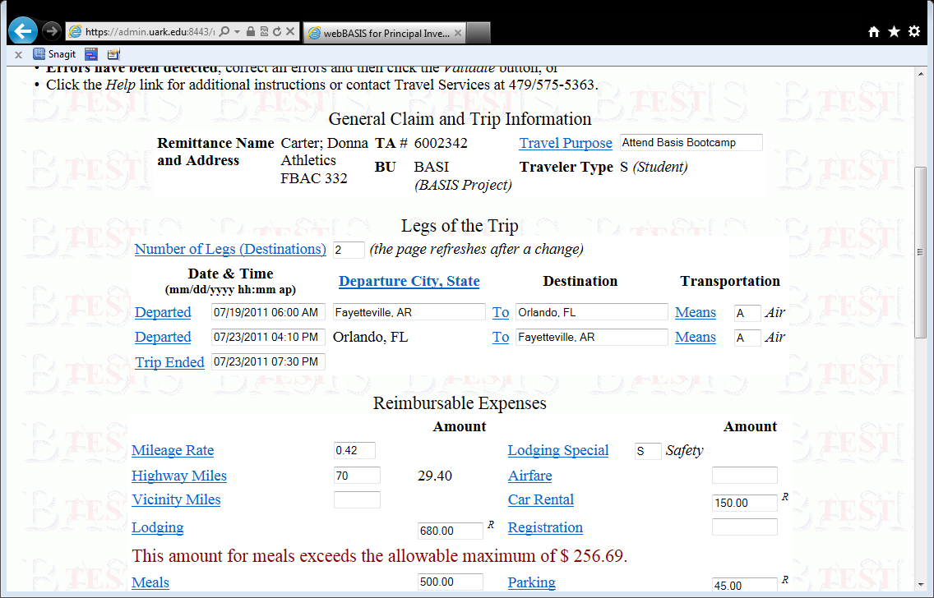
Notes:
Once you have entered all of your information, press the ‘Validate’ button at the bottom of the screen. If you have exceeded the maximum meal allowance for your trip, you will receive this message. You must change the amount in the meals field to not exceed the maximum allowable amount.

Slide 13
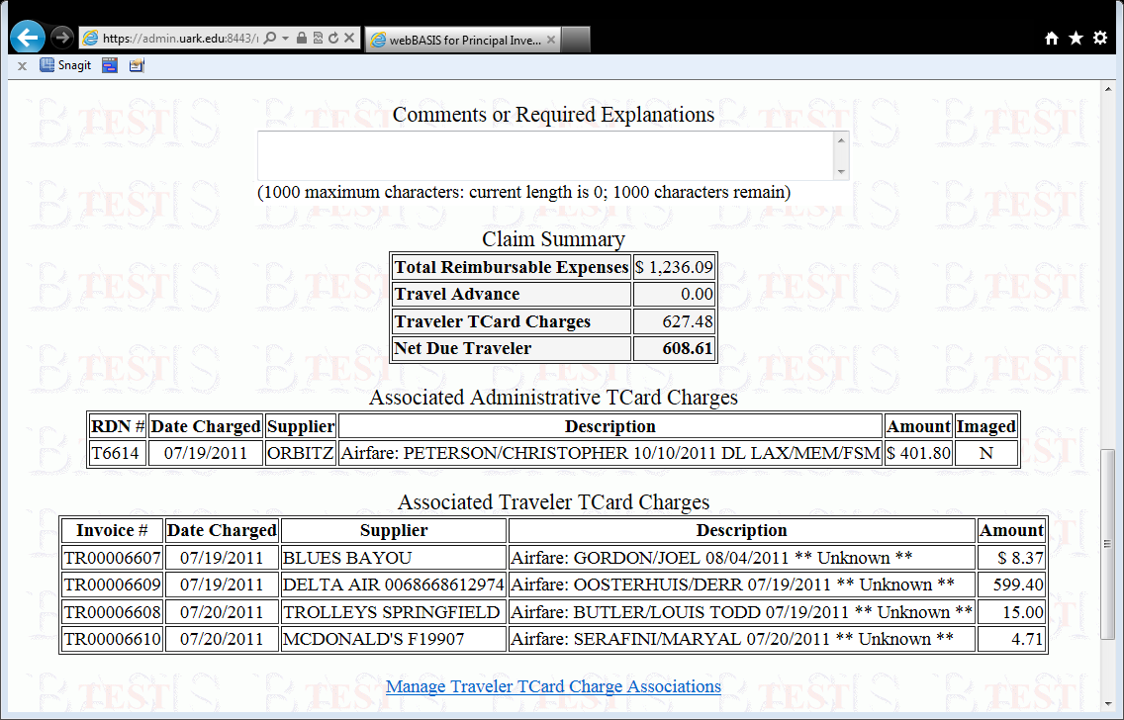
Notes:
Notice now that the system has totaled your reimbursable expenses and deducted the amount you put on your Traveler Tcard and you will be issued a check, or a direct deposit will be made in your bank account for the amount due the traveler.

Slide 14
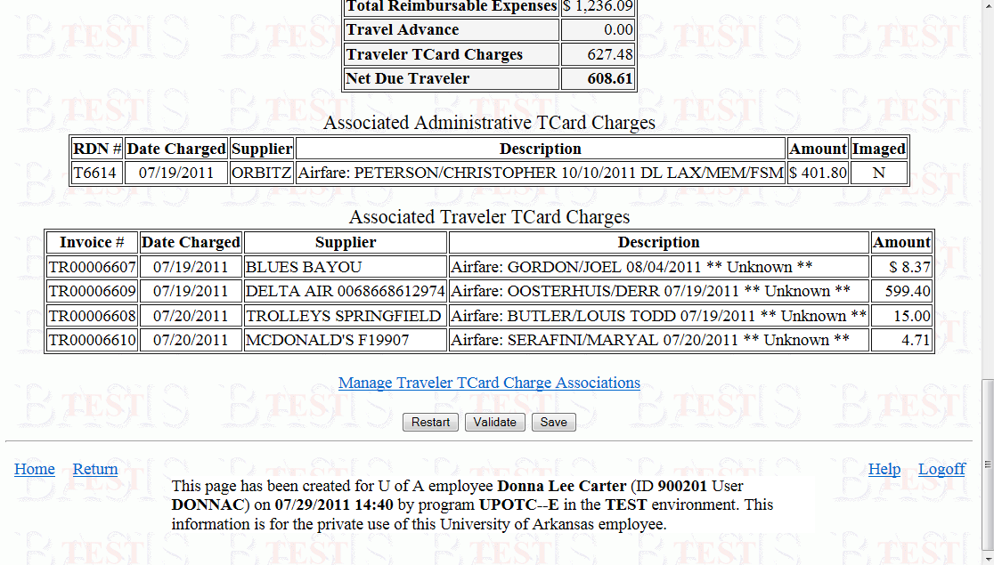
Notes:
Click the ‘Save’ button

Slide 15
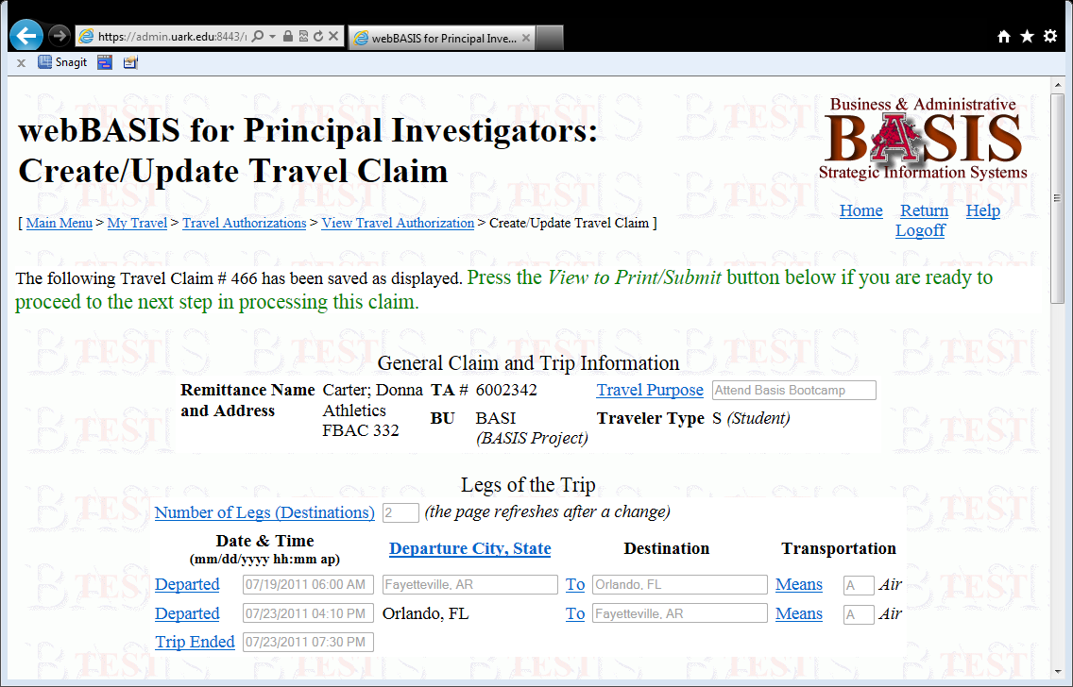
Notes:
Once you save, you will receive this message.

Slide 16
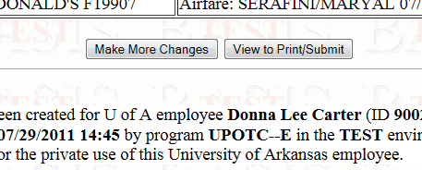
Press the View to Print/Submit Button

Slide 17
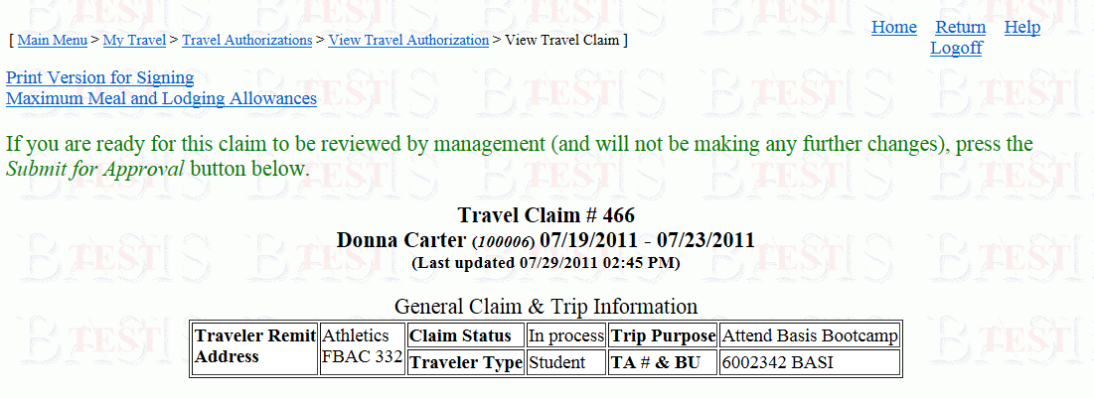
Click on the Print Version for Signing to pull up a window
to print your travel claim
Notes:
Once you click on the Print Version for Signing a separate window will open for you to print the travel claim. The travel claim will print on multiple pages depending on the claim. You will have a cover sheet that will also print.

Slide 18
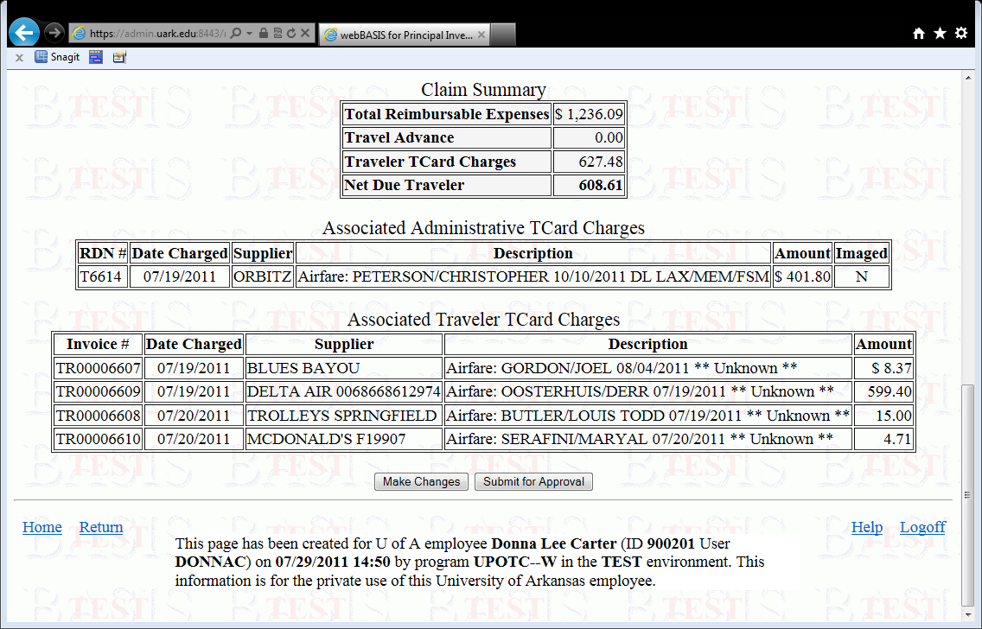
Notes:
Once you print your claim, close the window and scroll down to ‘Submit for Approval’ button. Click on this button and the claim will route for electronic approval.

